Slide 1
HoMonit: Monitoring Smart Home Apps from Encrypted Traffic
Wei Zhang¹, Yan Meng¹, Yugeng Liu¹, Xiaokuan Zhang², Yinqian Zhang², and Haojin Zhu¹
1Shanghai Jiao Tong University
2The Ohio State University
October, 2018

Slide 2
Outline
Background
Motivation
Design Overview
DFA Building via SmartApp Analysis
Misbehavior Detection via Wireless Fingerprint
Evaluation
Discussion
Conclusion

Slide 3
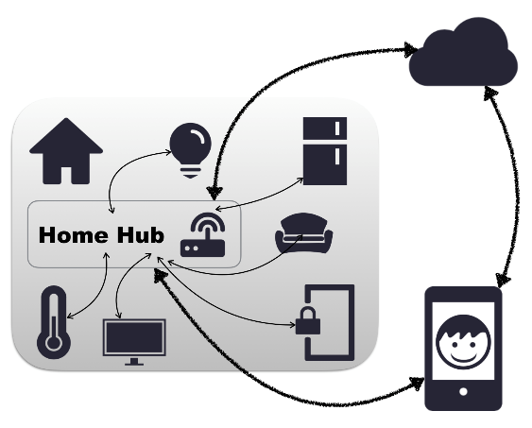
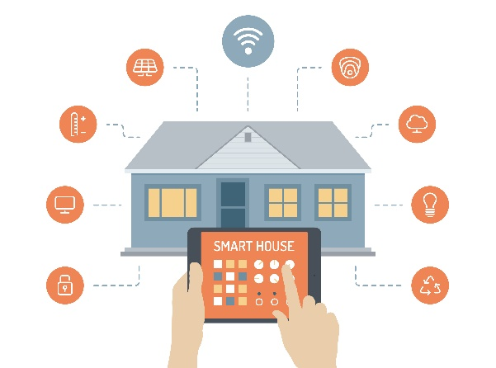
Background
Smart home, a concept of Internet of Things (IoT)
Cloud
Internet of Things
Client
Control multiple devices and let them work together
Smart Home

Slide 4
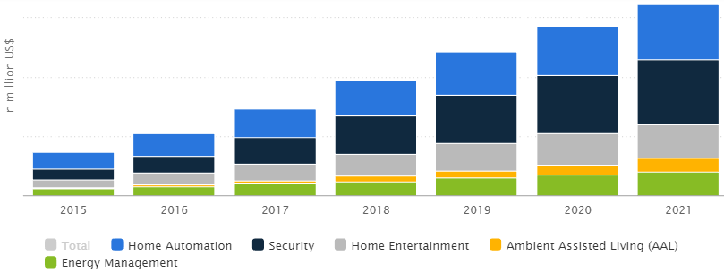
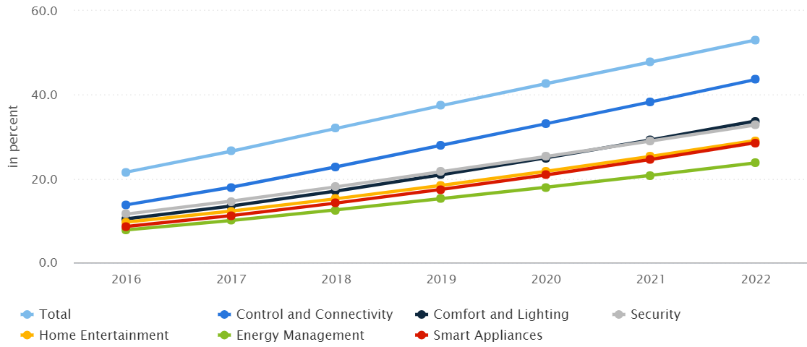
Background
Rapid growth of smart home market
Market Revenue
$18,877 million in 2018
Annual growth rate: 14.8%
Household Penetration
32.0% in 2018
Expected to hit 53.1% by 2022
＊Source: Statista, 2018

Slide 5
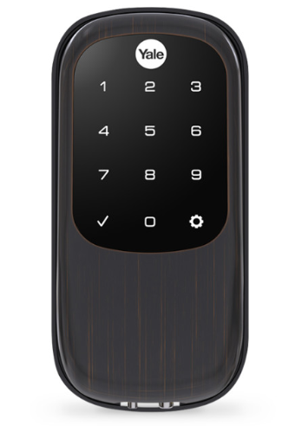
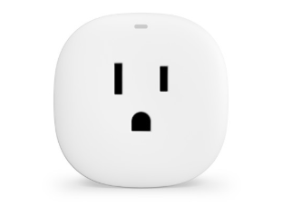
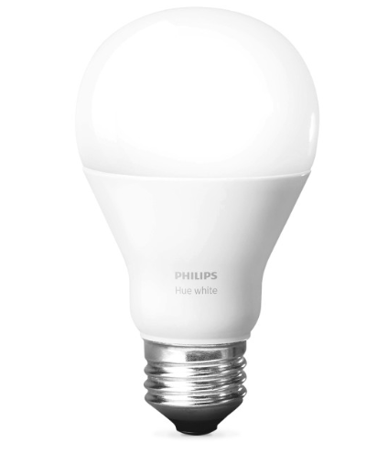
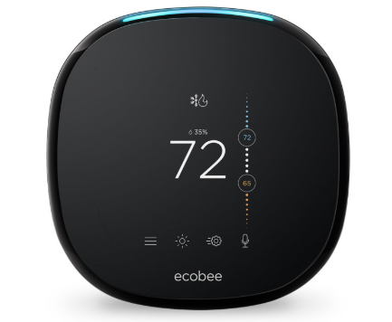
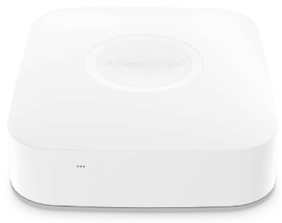
Smart Home Platforms
Smart devices are produced by different vendors
Control multiple devices and let them work together
Enable different devices to communicate through a local gateway or cloud backend
Smart Home Platform:
inter-vendor compatibility
software development ecosystems

Slide 6
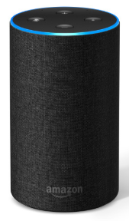
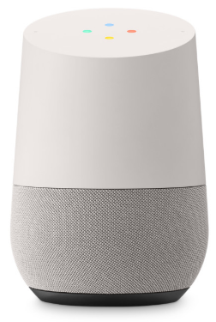
Smart Home Platforms
Prominent examples of smart home platforms
A popular platform promoted by Samsung
A developer-friendly ecosystem
Support 133 device types and 181 SmartApps in the official GitHub repo
Platform to study in our work
Amazon Echo
Google Home
Apple HomeKit

Slide 7
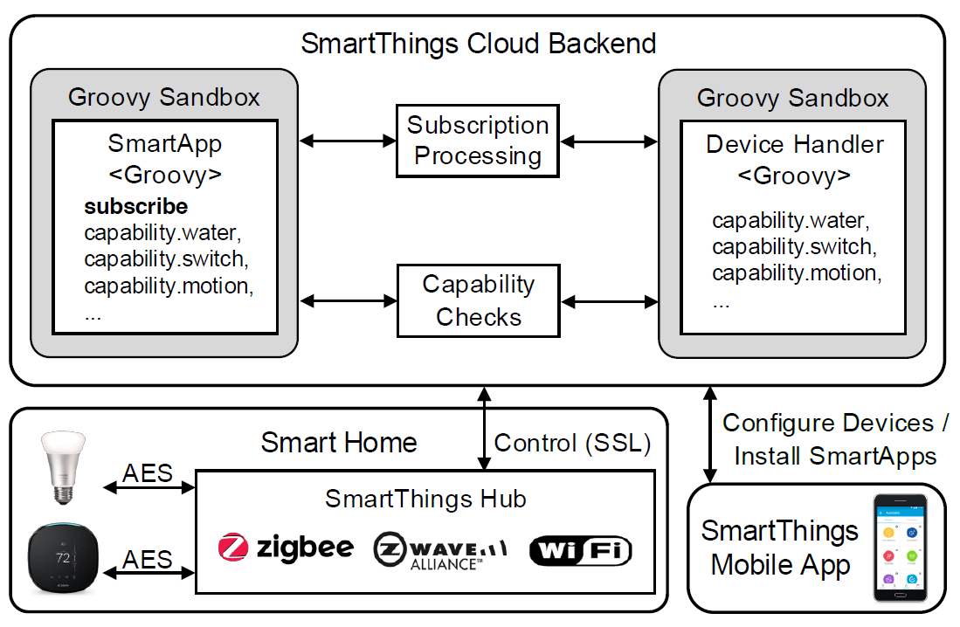
SmartThings
SmartThings architecture

Slide 8
SmartThings
SmartThings architecture
SmartThings Cloud Backend
Brain of smart home
Remotely control smart devices
Communicate with user
Host device handlers and SmartApps

Slide 9
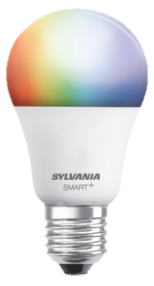
SmartThings
SmartThings architecture
Cloud: Device Handler
Virtual representations of physical devices
Abstract away the implementation details of the protocols for communicating to the devices
Specify the capabilities of these devices
Commands
on()
off()
Capability
switch
Light

Slide 10
SmartThings
SmartThings architecture
Cloud: SmartApps
Groovy-based programs
Automate devices with capabilities
181 SmartApps (open source) in the official GitHub repository
52 SmartApps (closed source) in SmartThings Marketplace

Slide 11
SmartThings
SmartThings architecture

Slide 12
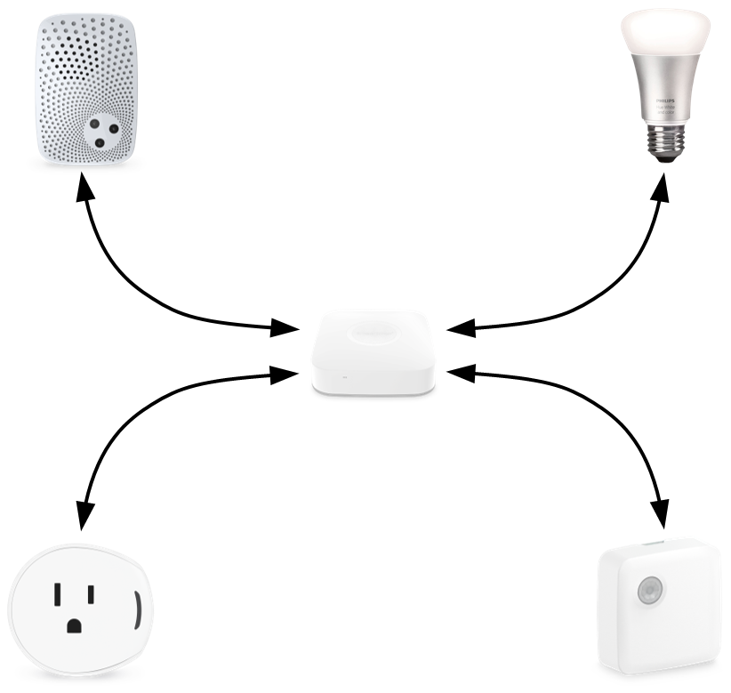
SmartThings
cloud
Device 1
Device 2
SmartThings architecture
Hub
Local Smart Home
Smart Devices
Key building blocks of the entire infrastructure
Connect to the hub with communication protocols
SmartThings Hub
Mediate the communication with all connected devices
Serve as the gateway to the SmartThings cloud
Device 3
Device 4

Slide 13
SmartThings
SmartThings architecture
Communication Protocols for Smart Home
Wireless standards designed for IoT
Low data transmission rate
Low power consumption
Support AES Encryption

Slide 14
SmartThings
SmartThings architecture
User interface

Slide 15
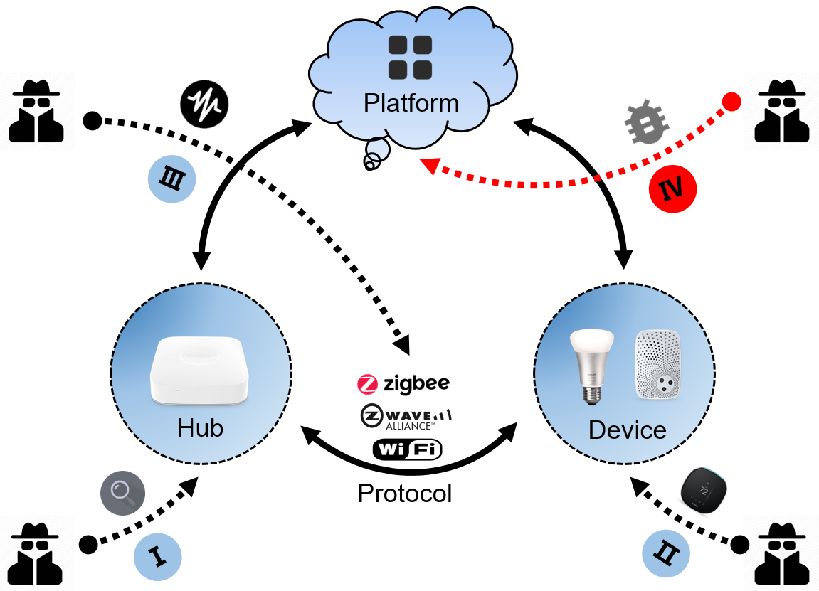
Smart Home Security
Misbehaving SmartApps
Platform (SmartThings) - Attack
Security analysis of emerging smart home applications
Fernandes et al. (S&P 2016)
Identify several design vulnerabilities of SmartThings
Over-privileged accesses
Event spoofing

Slide 16
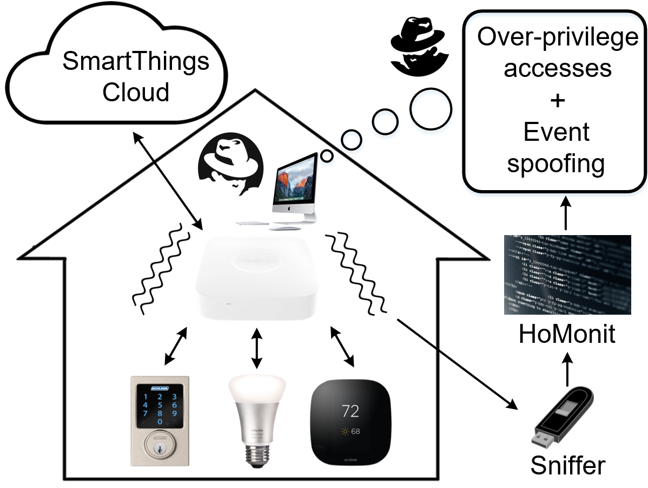
Threat Model
Over-privileged access : gaining control of the smart device capabilities which are not granted by the user

Slide 17
Threat Model
Event spoofing : spoofing event on cloud backend to trigger actions

Slide 18
Smart Home Security
Existing works mainly fall in to three categories
Platform (SmartThings) - Defense
Apply information flow control to confine sensitive data
Flowfence (USENIX Security 2016)
Context-based permission system
ContexIoT (NDSS 2017)
Enforce context-aware authorization by app analysis
SmartAuth (USENIX Security 2017)
Platform modification
Patching SmartApp

Slide 19
Smart Home Security
Existing works mainly fall in to four categories
Platform (SmartThings) - Defense
Apply information flow control to confine sensitive data
Flowfence (USENIX Security 2016)
Context-based permission system
ContexIoT (NDSS 2017)
Enforce context-aware authorization by app analysis
SmartAuth (USENIX Security 2017)
Is it possible to find a detection system without platform modification or app patching?

Slide 20
Our Design: HoMonit
HoMonit : a novel platform-independent anomaly detection system for monitoring smart home apps
Can we detect SmartApp misbehavior from its encrypted traffic?
Encrypted traffic

Slide 21
Outline
Background
Motivation
Design Overview
DFA Building via SmartApp Analysis
Misbehavior Detection via Wireless Fingerprint
Evaluation
Discussion
Conclusion

Slide 22
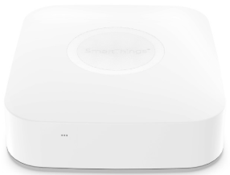
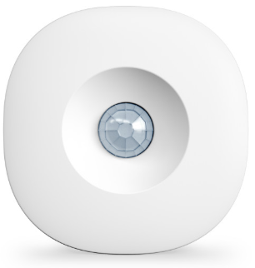
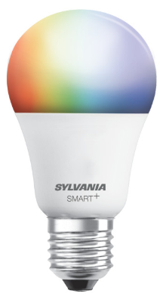
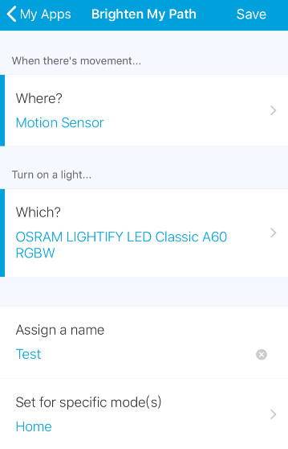
Motivation
Hub
Motion
Switch
Device
SmartApp

Slide 23
Motivation
Hub
Motion
Switch
Device
SmartApp

Slide 24
Motivation
Hub
Motion
Switch
Device
SmartApp

Slide 25
Motivation
similar
Hub
Motion
Switch
Device
SmartApp

Slide 26
Motivation
different
Hub
Motion
Switch
Device
SmartApp

Slide 27
Motivation
Hub
Motion
Switch
Event traffic usually has unique and fixed pattern
Device
Protocols have low entropy property
Applied protocols are designed for low data rate and low power consumption
SmartApp

Slide 28
Motivation
Another observation
Traffic → state machine
Working logic → state machine
SmartApp

Slide 29
Motivation
sniffer
Hub
Motion
Switch
Current working SmartApp
benign
infer
Basic idea of HoMonit
Misbehaviors
Over-privileged accesses
Event spoofing
Inconsistent working logic

Slide 30
Challenges
How to automatically extract the control logic (i.e., DFA) of both open-source and closed-source SmartApps?

Slide 31
Challenges
How to automatically extract the control logic (i.e., DFA) of both open-source and closed-source SmartApps?
How to automatically capture wireless traffic (i.e., ZigBee and Z-Wave) and conduct side-channel inference to detect SmartApp misbehaviors?

Slide 32
Challenges
How to automatically extract the control logic (i.e., DFA) of both open-source and closed-source SmartApps?
How to automatically capture wireless traffic (i.e., ZigBee and Z-Wave) and conduct side-channel inference to detect SmartApp misbehaviors?
How to implement and evaluate detection accuracy in a real-world smart home deployment?

Slide 33
Outline
Background
Motivation
Design Overview
DFA Building via SmartApp Analysis
Misbehavior Detection via Wireless Fingerprint
Evaluation
Discussion
Conclusion

Slide 34
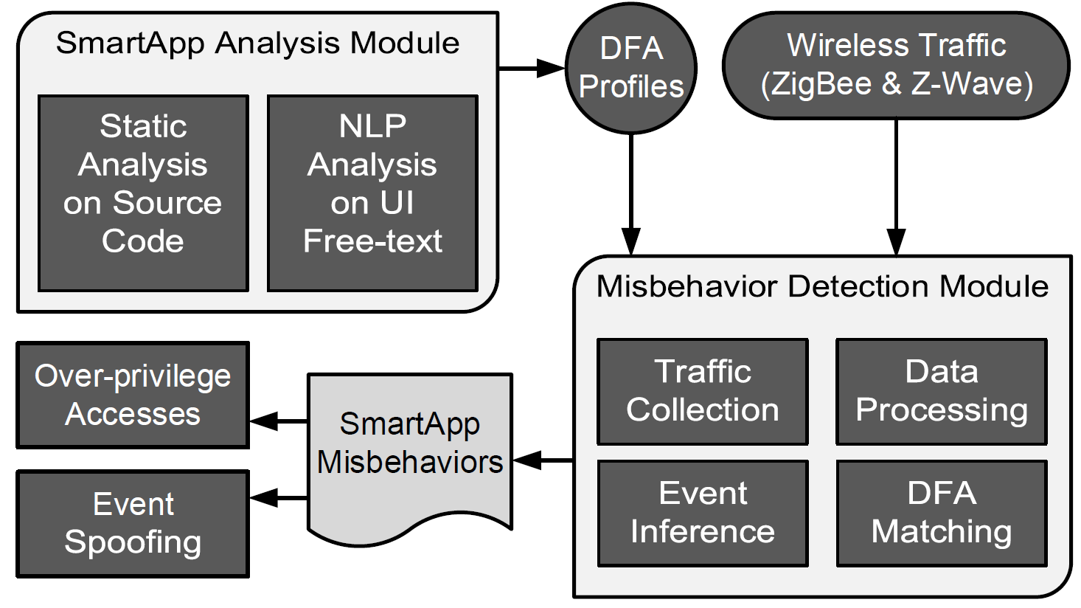
System Workflow

Slide 35
System Workflow
How to extract the control logic of both SmartApps?
How to capture wireless traffic and conduct side-channel inference?

Slide 36
Outline
Background
Motivation
Design Overview
DFA Building via Benign SmartApp Analysis
Misbehavior Detection via Wireless Fingerprint
Evaluation
Discussion
Conclusion

Slide 37
DFA Building via SmartApp Analysis

Slide 38
DFA Building via SmartApp Analysis
We utilize Deterministic Finite Automaton (DFA) to model SmartApp and build the model by app analysis
start state
accept state
symbol
transition

Slide 39
DFA Building via SmartApp Analysis
We handle app analysis in two perspectives:
Open-source SmartApps → Static code analysis
Closed-source SmartApps → NLP analysis

Slide 40
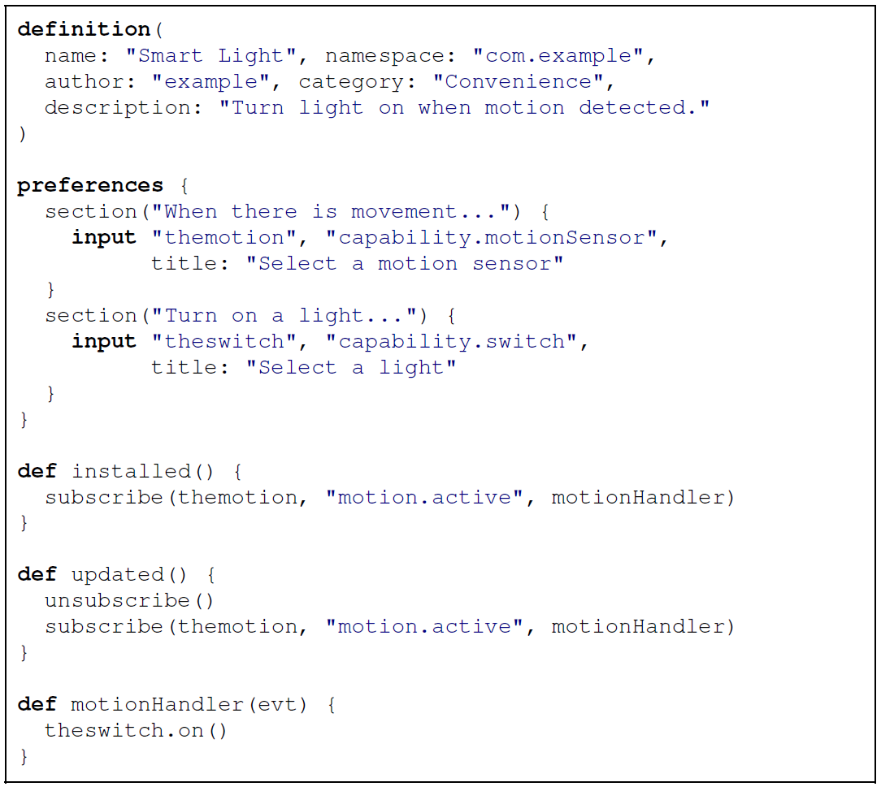
DFA Building for Open-source Apps
Take a SmartApp Smart Light as example
It turns light on when motion is detected
Therefore, it automates two devices
Source code:
Static analysis

Slide 41
DFA Building for Open-source Apps
We achieve DFA building in two steps:
Source code → AST → DFA
We use AstBuilder to convert code into Abstract Syntax Tree (AST).
The translation from AST to DFA is completed based on SmartApp characteristics

Slide 42
DFA Building for Open-source Apps
DFA building: infer DFA symbols
preferences → capability
[motionSensor]
[switch]
subscribe
→ command & attribute
[motion.active]

Slide 43
DFA Building for Open-source Apps
Preferences block statement
Extract the capabilities requested by DFA
Subscribe method
Further determine the specific symbols of DFA
symbol

Slide 44
DFA Building for Open-source Apps
DFA building: infer DFA transitions
subscribe
→ initial transition
S0 → [motion.active] → S1
Handler method
→ intermediate transition S1 → [switch.on())] → S2

Slide 45
DFA Building for Open-source Apps
Subscribe method
Indicate one transition from start state to intermediate state
Handler method (may contain if-else logic)
Determine how the state will transition to other states
transition & states

Slide 46
What if we do not have access to the source code of SmartApps?

Slide 47
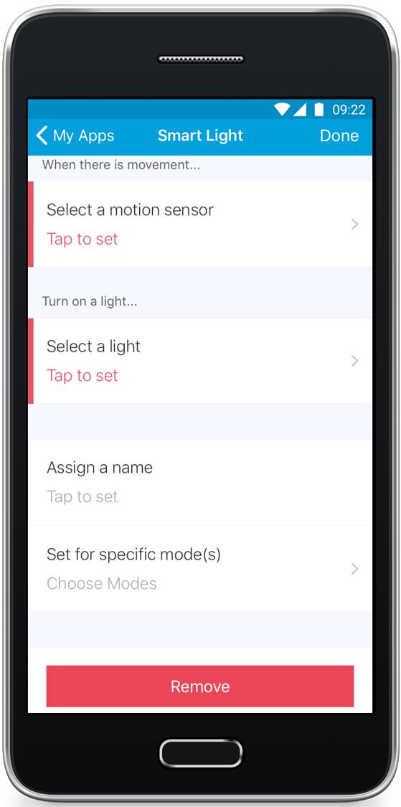
DFA Building for Closed-source Apps
Still the same SmartApp
Smart Light
Now turn our eyes towards its app interface (i.e., UI)
Working logic
Prompt Sentences

Slide 48
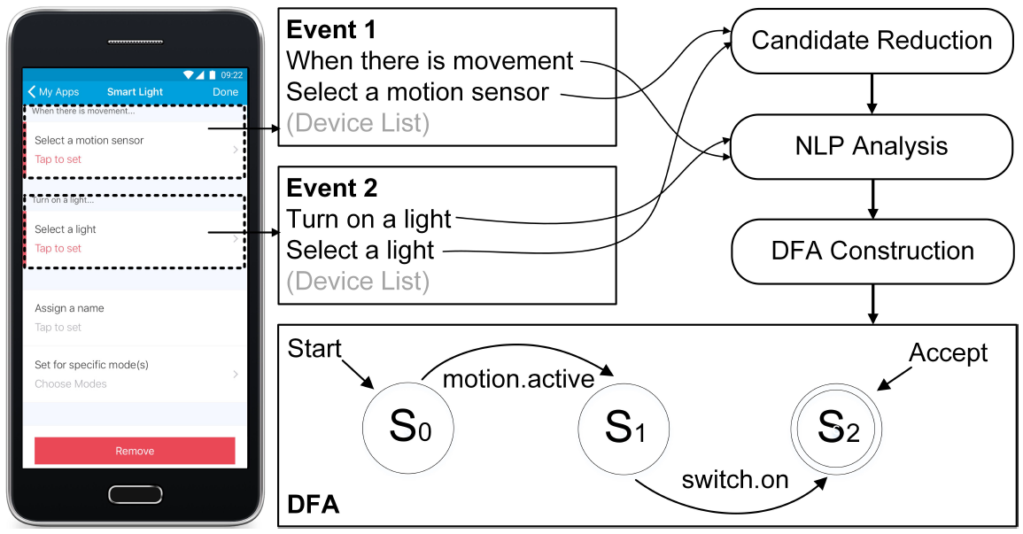
DFA Building for Closed-source Apps
Text extraction
Symbol inference
DFA building
Our method
NLP

Slide 49
DFA Building for Closed-source Apps
Text extraction
Symbol inference
DFA building
We apply uiautomator to convert the UI hierarchy into XML nodes and then extract the text
<node index="0" text="When water is sensed"
Resource-id="com.smartthings.android:id/title">

Slide 50
DFA Building for Closed-source Apps
Text extraction
Symbol inference
DFA building

Slide 51
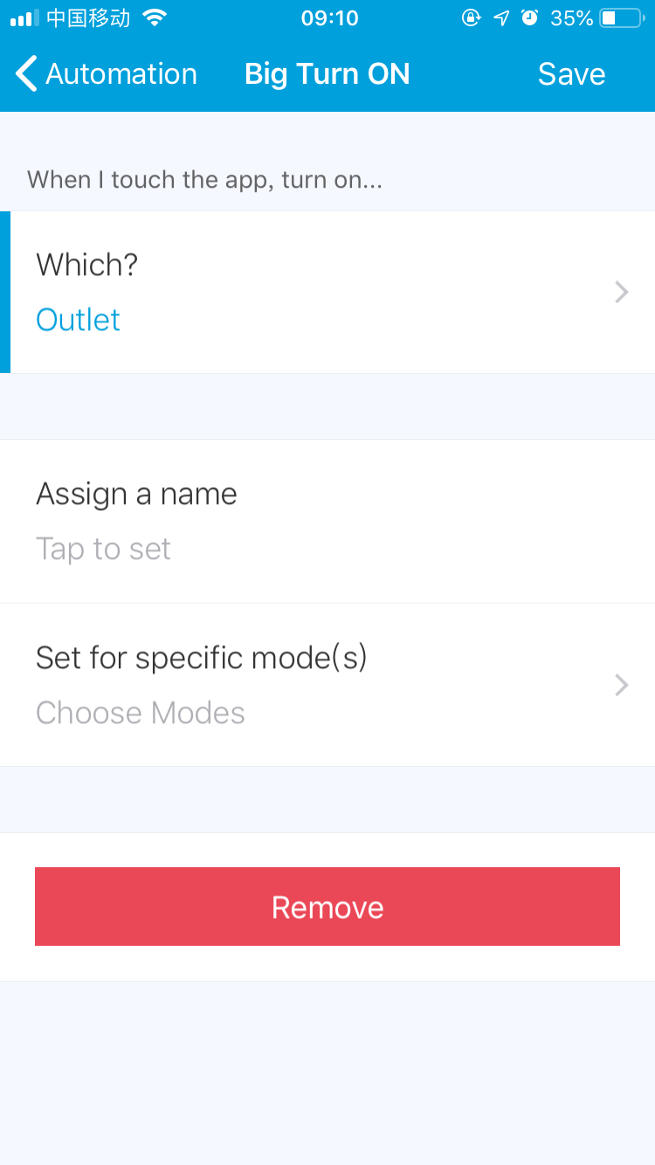
DFA Building for Closed-source Apps
Symbol inference
Alarm
Color Control
Color Temperature
Switch
Switch Level
Light
Power Meter
Outlet
NLP Analysis
Directly applying NLP for UI text can not achieve good performance
Switch.on()
Final symbol
UI text
Capability candidate sets

Slide 52
DFA Building for Closed-source Apps
Text extraction
Symbol inference
DFA building
Directly applying NLP for UI text can not achieve good performance
Our strategy : reduce candidate numbers before using NLP
No adequate training data for SmartThings

Slide 53
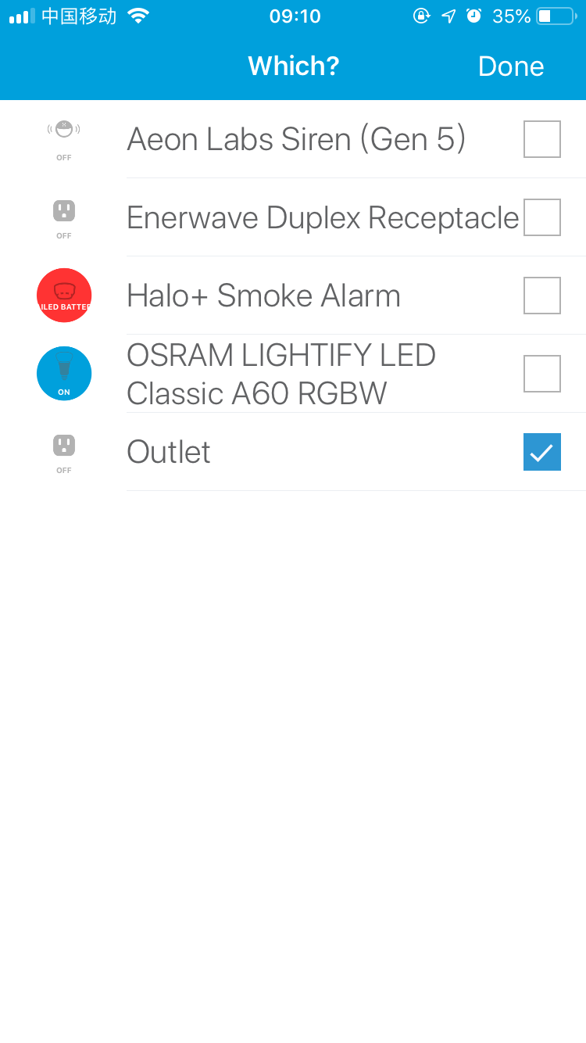
DFA Building for Closed-source Apps
Text extraction
Symbol inference
DFA building
Candidate reduction
Text descriptions for SmartApps require a unique language model
However, our training set is inadequate
Our strategy : test all the device candidates for a certain SmartApp and reduce the candidate set in advance
Test each options
Reduced candidate device set

Slide 54
DFA Building for Closed-source Apps
Alarm
Switch
Text extraction
Symbol inference
DFA building
Color Control
Color Temperature
Switch
Switch Level
Light
Reduced
capability
candidates
Candidate reduction
Text descriptions for SmartApps require a unique language model
However, our training set is inadequate
Our strategy : test all the device candidates for a certain SmartApp and reduce the candidate set in advance
Switch
Switch
Power Meter
Outlet
∩
Reduced to 1
Capability candidate set

Slide 55
DFA Building for Closed-source Apps
Alarm
Color Control
Color Temperature
Switch
Switch Level
Light
Power Meter
Outlet
NLP
hard
Switch.on()
Final symbol
Before
easy
Switch
NLP
After
UI text

Slide 56
DFA Building for Closed-source Apps
Text extraction
Symbol inference
DFA building
NLP analysis
NLTK : extract the noun phases and verb phrased for capability analysis
water → Water Sensor
Word2Vec : analyze the context of the verb phrases and then determine the state of attributes or commands
when water is sensed → water.wet

Slide 57
DFA Building for Closed-source Apps
Text extraction
Symbol inference
DFA building

Slide 58
DFA Building for Closed-source Apps
Text extraction
Symbol inference
DFA building
DFA building
UI design follows the symbol logical relationship
Chain the symbols according to the UI layout
“ When there is movement, turn on a light ”
Symbol
logic

Slide 59
Outline
Background
Motivation
Design Overview
DFA Building via SmartApp Analysis
Misbehavior Detection via Wireless Fingerprint
Evaluation
Discussion
Conclusion

Slide 60
Misbehavior Detection via Wireless Fingerprint
Traffic collection
Event Inference
DFA Matching

Slide 61
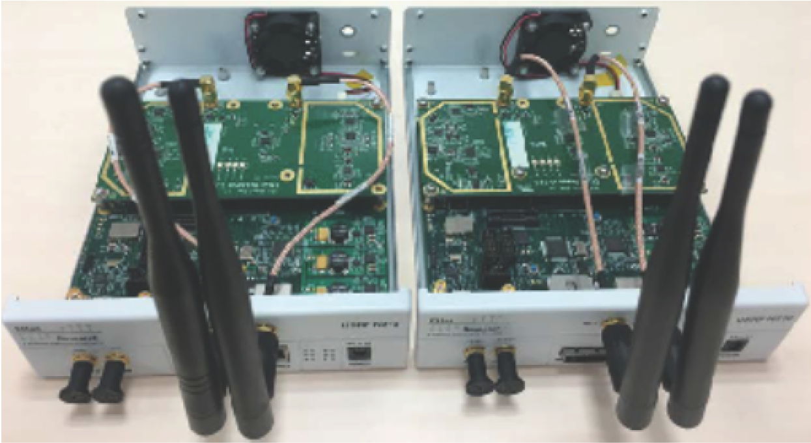
Event Inference
Traffic collection
Traffic collection
ZigBee traffic
TI CC2531 USB Dongle
802.15.4 monitor
2.4GHz
Z-Wave traffic
USRP
Scapy-Radio
908.4MHz and 916MHz
Filtering noise traffic
Fingerprinting events
Inferring events

Slide 62
Event Inference
Traffic collection
Filtering noise traffic
Beacon packets
Used for acknowledging data transmission and maintaining established connection
Retransmission packets
Used for transmission failure
Unrelated traffic
Traffic from devices using other wireless standards (e.g., WiFi)
Filtering noise traffic
Fingerprinting events
Inferring events

Slide 63
Event Inference
Traffic collection
Filtering noise traffic
Beacon packets
Used for acknowledging data transmission and maintaining established connection
Retransmission packets
Used for transmission failure
Unrelated traffic
Traffic from devices using other wireless standards (e.g., WiFi)
Filtering noise traffic
Fingerprinting events
Inferring events

Slide 64
Event Inference
Traffic collection
Fingerprinting events
We adopt Levenshtein Distance to measure the similarity between packet sequence
Filtering noise traffic
Fingerprinting events
event type
collected packet sequence
fingerprint
Inferring events

Slide 65
Event Inference
Traffic collection
Event name
switch.off
Fingerprinting events
We adopt Levenshtein Distance to measure the sequence similarity between packet sequence
Device name
Samsung SmartThings Outlet
Filtering noise traffic
Protocol
ZigBee
50 ↓ 47 ↓ 47 ↓ 52 ↓
50 ↓ 47 ↓ 47 ↓ 52 ↓ 52 ↓
50 ↓ 47 ↓ 47 ↓ 52 ↓
50 ↓ 47 ↓ 47 ↓ 52 ↓
50 ↓ 47 ↓ 52 ↓
50 ↓ 47 ↓ 47 ↓ 52 ↓
…
Fingerprinting events
Packet sequence
event type
Smallest distance
collected packet sequence
fingerprint
Inferring events
Fingerprint
50 ↓ 47 ↓ 47 ↓ 52 ↓

Slide 66
Event Inference
Fingerprints for event types supported by 11 devices
Traffic collection
Inferring events
Partition the traffic flow into a set of bursts (a group of consecutive packets within burst threshold)
Match the burst with the possible fingerprint by calculating their Levenshtein Distance
Filtering noise traffic
Fingerprinting events
Inferring events

Slide 67
Event Inference
Traffic collection
Inferring events
Partition the traffic flow into a set of bursts (a group of consecutive packets within burst threshold)
Match the burst with the possible fingerprint by calculating their Levenshtein Distance
Filtering noise traffic
Fingerprinting events
Inferring events
Find smallest

Slide 68
SmartApp Misbehavior Detection
DFA matching algorithm
Input
A sequence of events
Initially, . For each event in sequence, transition DFA if
Process
Accept state:
Otherwise a misbehaved SmartApp is detected
Output

Slide 69
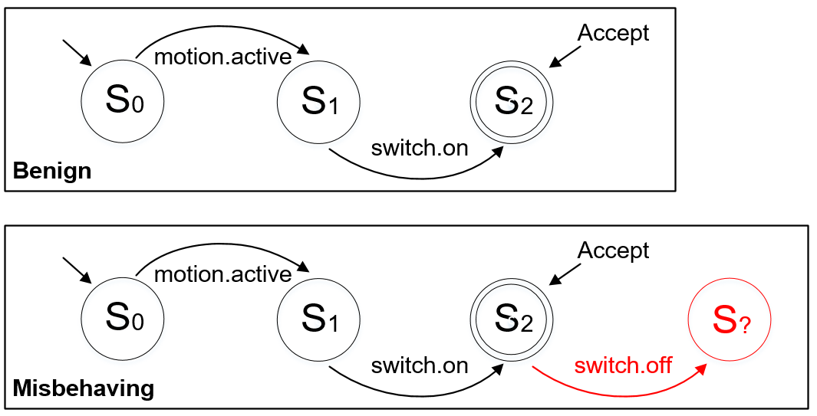
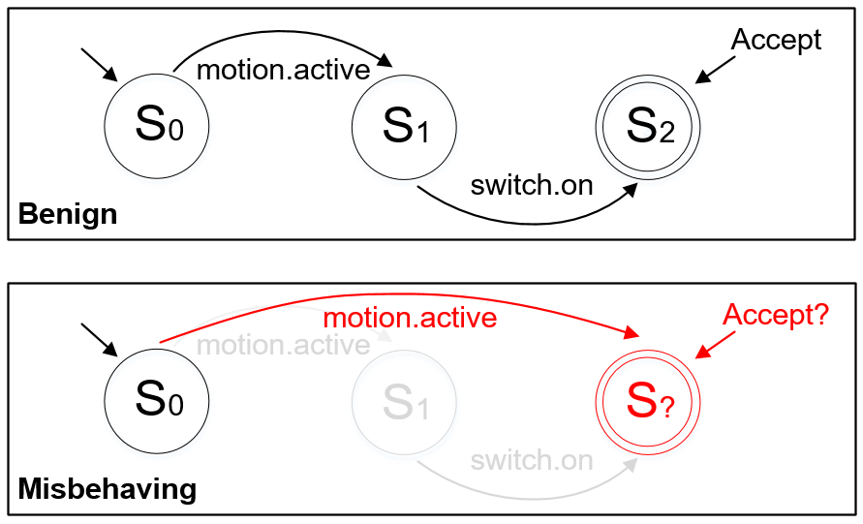
SmartApp Misbehavior Detection
Over-privilege accesses
Event spoofing
Raising extra device event
Skipped states
Benign
Misbehaving

Slide 70
Outline
Background
Motivation
Design Overview
DFA Building via SmartApp Analysis
Misbehavior Detection via Wireless Fingerprint
Evaluation
Discussion
Conclusion

Slide 71
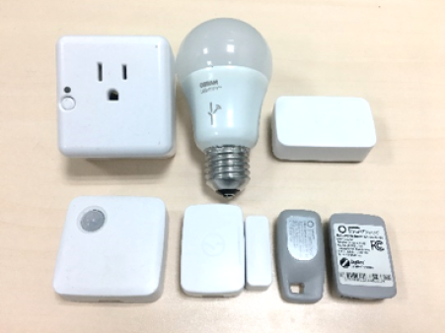
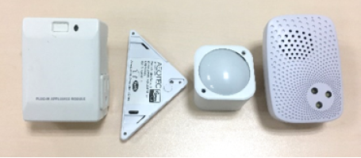
Testbed
ZigBee sniffing : TI CC2531 USB Dongle
Z-Wave sniffing : two USRPs
Distance between SmartThings hub and HoMonit is 7 feet
Dataset : 30 open-source SmartApps from
SmartThings Public GitHub Repository
Smart devices : 7 ZigBee devices (20 app) and 4 Z-Wave devices (10 app)

Slide 72
Misbehavior Detection
Reconsider the two types of attacks…
Platform (SmartThings) – Misbehavior types
Over-privileged accesses
Illegally obtaining accesses to command / all the capabilities of the devices
Event spoofing
A malicious SmartApp with the knowledge of the hub and device identifiers can spoof an arbitrary event
No available misbehaving app dataset:
Earlence Fernandes, Jaeyeon Jung, and Atul Prakash. 2016. Security analysis of emerging smart home applications. In IEEE Symposium on Security and Privacy (S&P).

Slide 73
Misbehavior Detection
Over-privileged accesses
Over-privileged access realization
We develop over-privileged apps by adding malicious code to cause unintended operations
Strategy
HoMonit detects this misbehavior by checking additional states in DFA matching process
Experiment
30 benign & misbehaving apps
3 volunteers to simulate residents
20 times triggering for each app

Slide 74
Misbehavior Detection
Event spoofing
Event spoofing realization
We develop event-spoofing apps by exploiting insufficient event protection mechanism to spoof a physical event and trigger subscribed apps
Strategy
HoMonit detects this misbehavior by checking missing states in DFA matching process
Experiment
Same approach as over-privilege access evaluation

Slide 75
Misbehavior Detection Result
Metrics
TP (true positive) : Correctly labeled misbehaving SmartApp
TN (true negative) : Correctly labeled benign SmartApp
FP (false positive) : Incorrectly labeled benign SmartApp
FN (false negative) : Incorrectly labeled misbehaving SmartApp
TPR (true positive rate) : TPR = TP / (TP + FN)
TNR (true negative rate) : TNR = TN / (FP + TN)

Slide 76
Misbehavior Detection Result
Metrics
Detection result of 60 misbehaving SmartApps
TP (true positive) : Correctly labeled misbehaving SmartApp
TN (true negative) : Correctly labeled benign SmartApp
FP (false positive) : Incorrectly labeled benign SmartApp
FN (false negative) : Incorrectly labeled misbehaving SmartApp
TPR (true positive rate) : TPR = TP / (TP + FN)
TNR (true negative rate) : TNR = TN / (FP + TN)

Slide 77
Misbehavior Detection Result
Metrics
Detection result of misbehavior occurrence in SmartApps
TP (true positive) : Correctly labeled misbehaving SmartApp
TN (true negative) : Correctly labeled benign SmartApp
FP (false positive) : Incorrectly labeled benign SmartApp
FN (false negative) : Incorrectly labeled misbehaving SmartApp
TPR (true positive rate) : TPR = TP / (TP + FN)
TNR (true negative rate) : TNR = TN / (FP + TN)
The average TPR for over-privileged accesses is 0.98
The average TPR for event spoofing is 0.99
Failed test case reason : packet loss, unexpected wireless traffic, accidental signal reception delay

Slide 78
Outline
Background
Motivation
Design Overview
DFA Building via SmartApp Analysis
Misbehavior Detection via Wireless Fingerprint
Evaluation
Discussion
Conclusion

Slide 79
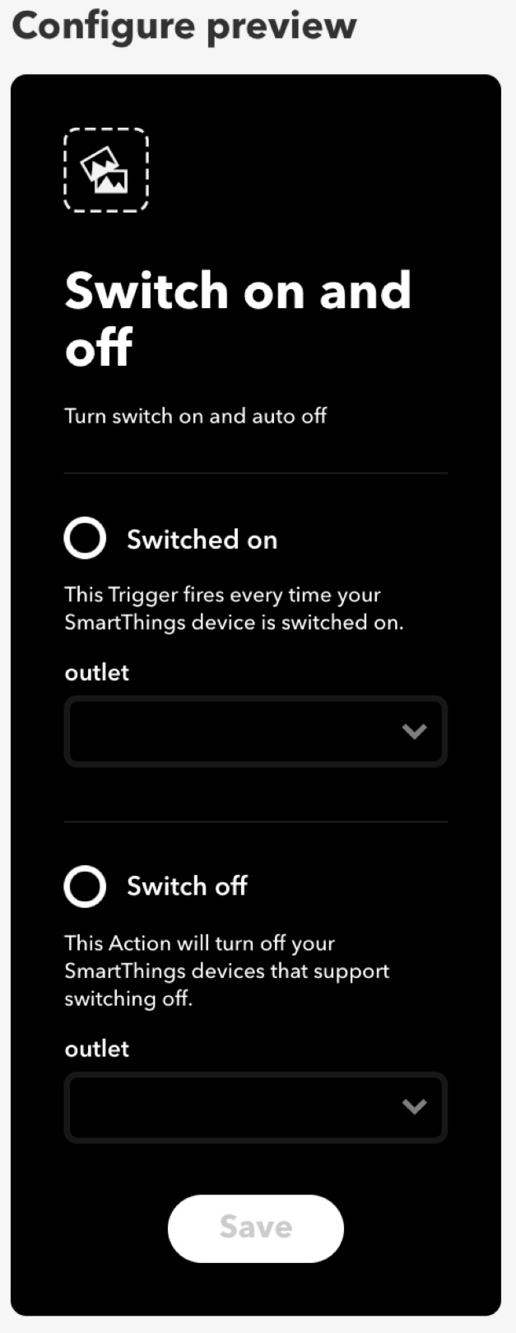
Generality
Our presented approach can be potentially applied to other IoT systems
Thought
We also investigate IFTTT, an open-source platform compatible with SmartThings
IFTTT
The events present the same wireless fingerprints &
Applets share similar logic
Result

Slide 80
Privacy Consideration
Side-channel information leakage is a double-edged sword
Daily routines : The attacker can spy on the victim’s daily activities
SmartApp Example
Good Night : change its mode when there is no human activity in the home
However, this side-channel inference attack requires placing a wireless sniffer in the proximity of smart home
Home occupations : The attacker can infer it by detecting the app existence
SmartApp Example
Vacation Lighting Director : deceptively control lights while residents are away
Health conditions : The attacker can infer the health condition of residents
SmartApp Example
Elder Care: Slip & Fall : monitor the behavior of the aged people

Slide 81
Outline
Background
Motivation
Design Overview
DFA Building via SmartApp Analysis
Misbehavior Detection via Wireless Fingerprint
Evaluation
Discussion
Conclusion

Slide 82
Conclusion
An anomaly detection system for smart home platforms to detect misbehaving SmartApps
HoMonit
Leverage the side-channel information leakage in the wireless channel to infer device event
Insight
Program logic extraction from source code or UI, and auto DFA construction & matching algorithms
Contribution
HoMonit can effectively validate the working logic of SmartApps and achieve a high accuracy in the detection of SmartApp misbehaviors
Performance

Slide 83
Thanks!
Q & A
Upcoming release: nsec.sjtu.edu.cn

