Slide 1

Backdoor Attacks Against Dataset Distillation
Yugeng Liu†, Zheng Li†, Michael Backes†, Yun Shen§, Yang Zhang†
†CISPA Helmholtz Center for Information Security §NetApp

Slide 2
Dataset Distillation
Goal of dataset distillation:
A model trained on this distilled dataset can attain comparable performance to a model trained on the original training dataset.

Slide 3
Motivation
Dataset distillation is a mixed blessing.
  It is a DNN model, vulnerable to the security and privacy attacks.

Slide 4


Motivation
Dataset distillation is a mixed blessing.
  It is a DNN model, vulnerable to the security and privacy attacks.
  It cannot be distinguished by naked eyes.
CIFAR10 distilled image

Slide 5
Motivation
Classic backdoor attacks cannot be directly applied to the distilled datasets.
  Distilled datasets are too small to launch such attacks.
  Human inspection can quickly mitigate such attacks.
Is it possible to inject triggers into a distilled dataset and launch backdoor attacks on the downstream model?

Slide 6
Attack Scenarios
We envision the attacker as the malicious dataset distillation service provider.
  The victim commissions to distill a specific dataset.
  The victim purchases a synthesized dataset to reduce the cost.

Slide 7
NAIVEATTACK

Slide 8
DOORPING

Slide 9
Experiment Settings
Dataset distillation technique.
  Dataset distillation (DD).
  Dataset condensation with gradient matching (DC).
Upstream models.
  AlexNet.
  ConvNet.
Evaluation metrics.
  Attack success rate (ASR).
  Clean test accuracy (CTA).

Slide 10
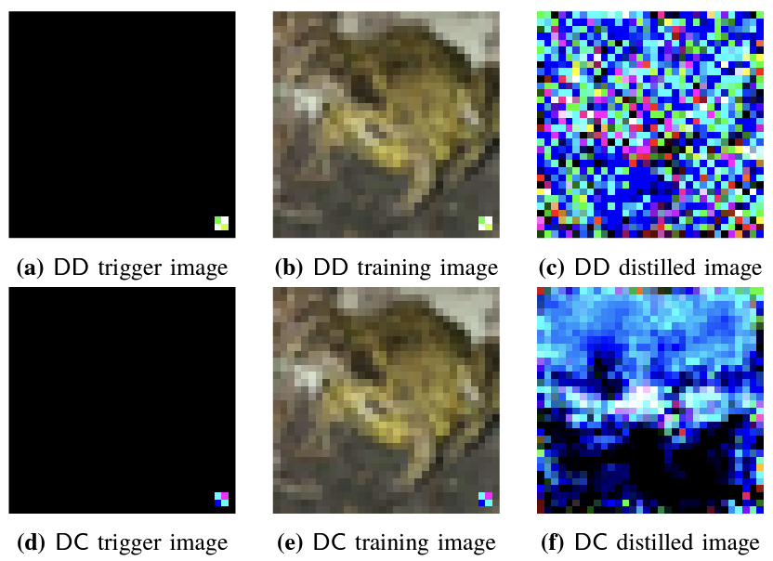
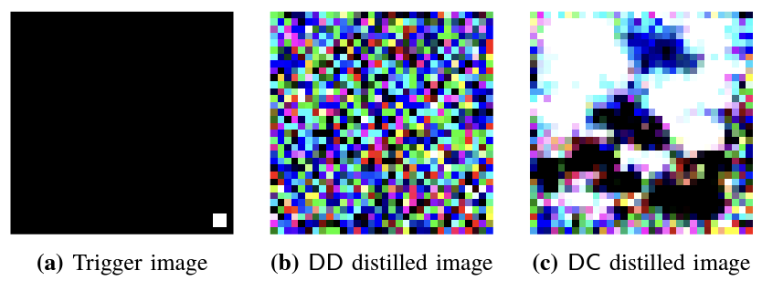
Experiment Results
Distilled images of NAIVEATTACK
Distilled images of DOORPING

Slide 11
Experiment Results

Slide 12
Effectiveness on Complex Datasets
we choose CIFAR100 dataset for the test.
 |  | DD Algorithm |  | DC Algorithm
 |  | ASR | CTA | ASR | CTA
Clean Model | AlexNet | 0.014 | 0.385 | 0.012 | 0.217
 | ConvNet | 0.029 | 0.215 | 0.012 | 0.197
NAIVEATTACK | AlexNet | 0.128 | 0.375 | 0.007 | 0.209
 | ConvNet | 0.011 | 0.214 | 0.006 | 0.190
DOORPING | AlexNet | 0.919 | 0.373 | 0.961 | 0.209
 | ConvNet | 1.000 | 0.205 | 1.000 | 0.196

Slide 13
Effectiveness on Cross Architectures
We choose three model architectures- AlexNet, ConvNet, VGG11.
  We use AlexNet (ConvNet) as the distillation model and the other two architectures for evaluation.
CIFAR10 |  | DD Algorithm |  |  | DC Algorithm
Upstream |  | AlexNet | ConvNet | VGG11 | AlexNet | ConvNet | VGG11
AlexNet | ASR | 0.999 | 0.471 | 0.471 | 1.000 | 0.108 | 1.000
 | CTA | 0.471 | 0.471 | 0.097 | 0.364 | 0.287 | 0.312
ConvNet | ASR | 0.000 | 1.000 | 0.200 | 1.000 | 1.000 | 1.000
 | CTA | 0.102 | 0.476 | 0.104 | 0.301 | 0.308 | 0.287

Slide 14


Trigger Trajectory
We collect these triggers and test them after the distillation.
The attack performance from these triggers can also achieve similar results as the distillation phase.

Slide 15
Defenses
Model Level |  | Input Level |  | Dataset Level
ABS | ❎ | De-noising Autoencoder | ❎ | SCAn | ❎
NAD | ❎ | De-trigger Autoencoder | ❎ | Spectral Signature | ❎
Neural Cleanse | ❎ | STRIP | ☑️ | SPECTRE | Partly

Slide 16
Thank You
Github repo: https://github.com/liuyugeng/baadd

