Slide 1


ML-DOCTOR: Holistic Risk Assessment of Inference Attacks Against Machine Learning Models
Yugeng Liu¹, Rui Wen¹, Xinlei He¹, Ahmed Salem¹, Zhikun Zhang¹,
Michael Backes¹, Emiliano De Cristofaro², Mario Fritz¹, Yang Zhang¹
¹CISPA Helmholtz Center for Information Security
²UCL & Alan Turing Institute

Slide 2
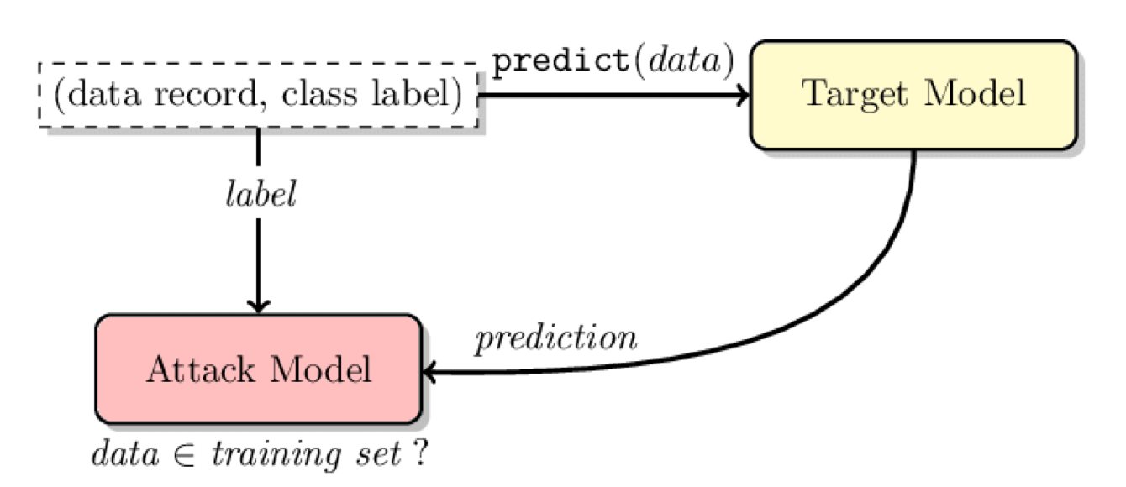
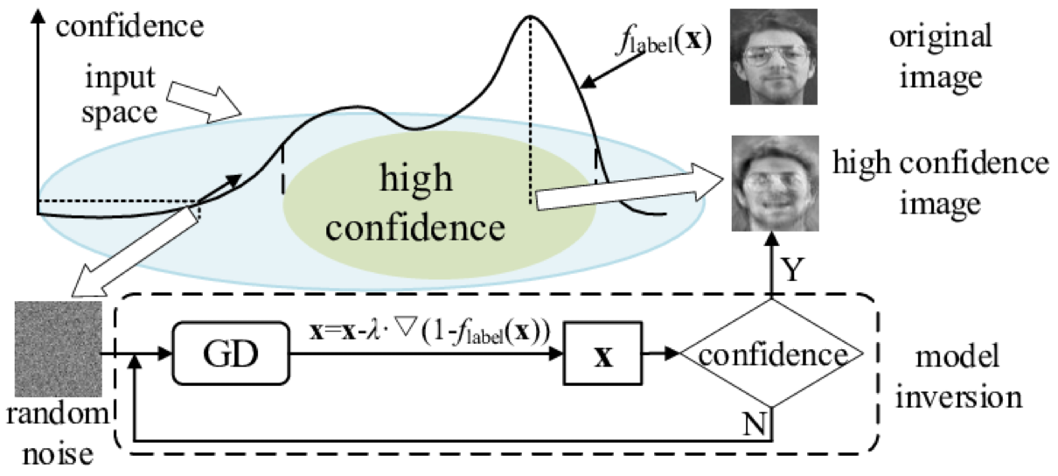
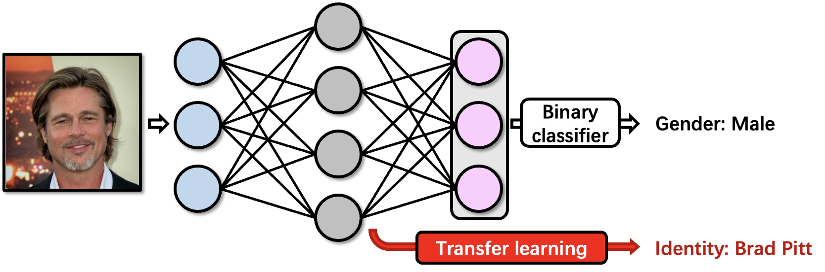
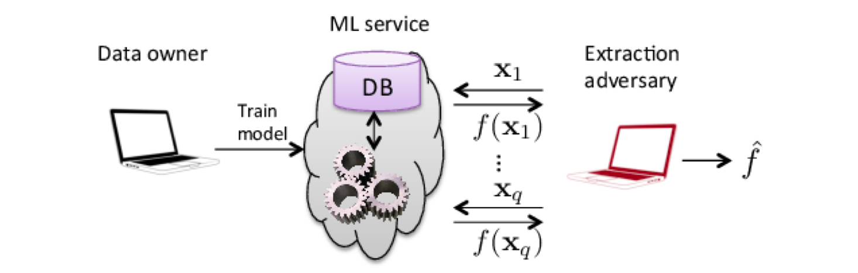
Background
Inference attacks
Membership inference (MemInf) ^{[1]}
Model inversion (ModInv) ^{[2]}
Attribute inference (AttrInf) ^{[3]}
Model stealing (ModSteal) ^{[4]}
[1] Shokri et al,. Membership Inference Attacks Against Machine Learning Models. Oakland, 2017.
[2] Fredrikson et al,. Model Inversion Attacks that Exploit Confidence Information and Basic Countermeasures. CCS, 2015.
[3] Song and Shmatikov. Overlearning Reveals Sensitive Attributes. In ICLR, 2020.
[4] Tramèr et al,. Stealing Machine Learning Models via Prediction APIs. USENIX Security, 2016.

Slide 3
Motivation
Existing inference attacks have been studied in isolation.
This prompts the need for a holistic research.

Slide 4
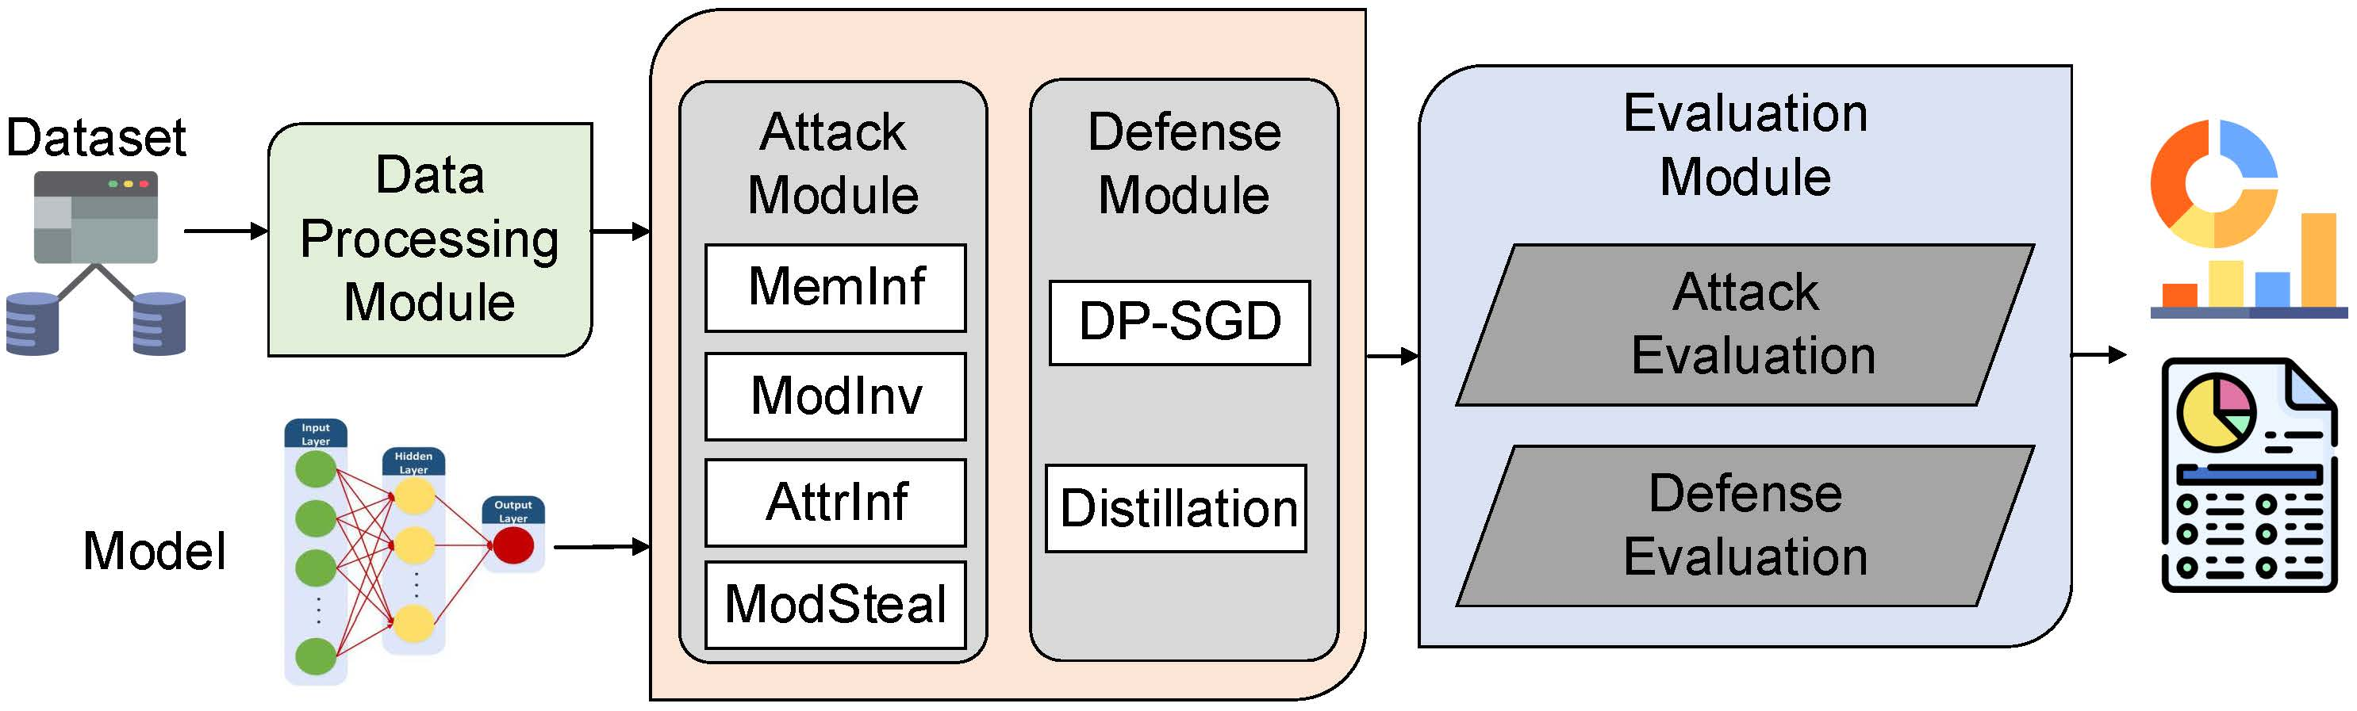
ML-Doctor Workflow

Slide 5
Research Questions
RQ1: What is the impact of dataset complexity on different attacks?
RQ2: What is the impact of overfitting on different attacks?
RQ3: What is the relationship among different attacks?

Slide 6
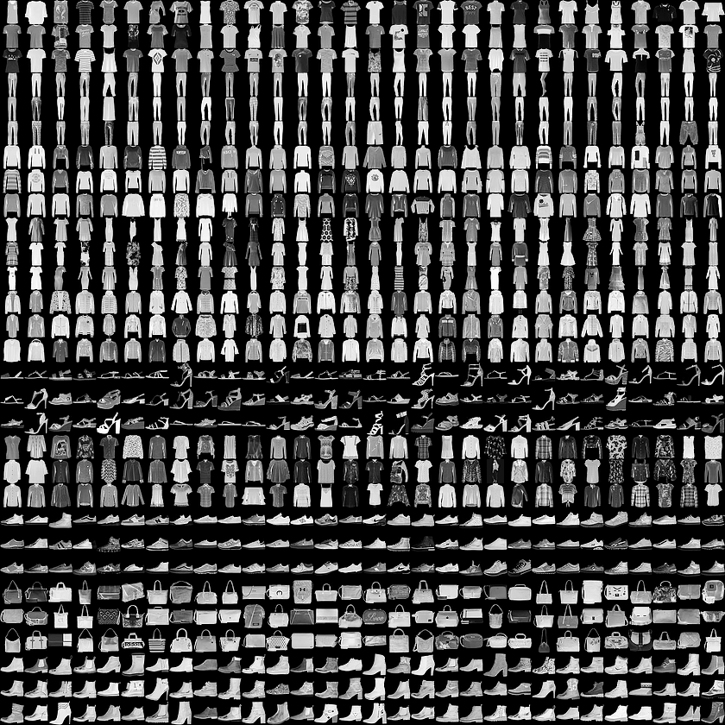

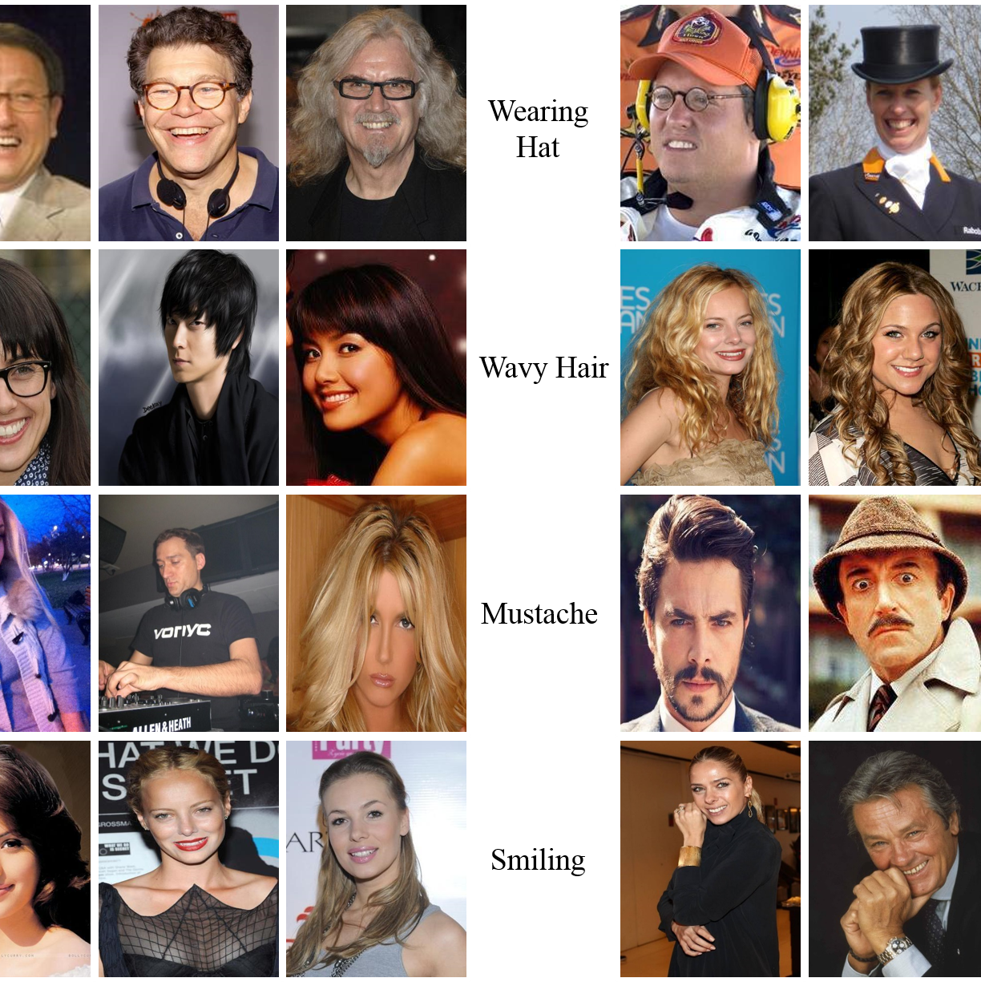
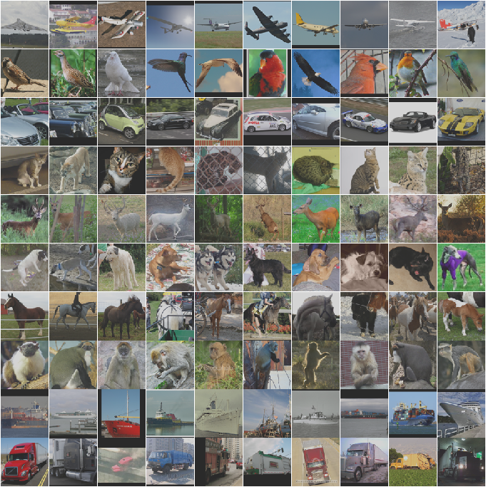
Research Questions
RQ1: What is the impact of dataset complexity on different attacks?
Dataset Complexity
<
<
<
FMNIST
UTKFace
CelebA
STL10

Slide 7
Research Questions
RQ1: What is the impact of dataset complexity on different attacks?

Slide 8
Research Questions
RQ1: What is the impact of dataset complexity on different attacks?
Overall, the complexity of the dataset does have a significant effect on MemInf, ModInv, and ModSteal.

Slide 9
Research Questions
RQ1: What is the impact of dataset complexity on different attacks?
Overall, the complexity of the dataset does have a significant effect on MemInf, ModInv, and ModSteal.
More complex datasets lead to better MemInf but worse ModSteal performance.

Slide 10
Research Questions
RQ1: What is the impact of dataset complexity on different attacks?
Overall, the complexity of the dataset does have a significant effect on MemInf, ModInv, and ModSteal.
More complex datasets lead to better MemInf but worse ModSteal performance.
There is no strong influence of dataset complexity on AttrInf.

Slide 11
Research Questions
RQ2: What is the impact of overfitting on different attacks?
Quantify overfitting:
  Overfitting level = training acc – testing acc.
  The number of epochs used to train the target model.
11

Slide 12
Research Questions
RQ2: What is the impact of overfitting on different attacks?
12

Slide 13
Research Questions
RQ2: What is the impact of overfitting on different attacks?
13

Slide 14
Research Questions
RQ2: What is the impact of overfitting on different attacks?
Overall, overfitting does have a significant impact on
MemInf, ModInv and ModSteal.
14

Slide 15
Research Questions
RQ2: What is the impact of overfitting on different attacks?
Overall, overfitting does have a significant impact on
MemInf, ModInv and ModSteal.
Higher overfitting level leads to better MemInf. ModSteal is the opposite.
15

Slide 16
Research Questions
RQ2: What is the impact of overfitting on different attacks?
Overall, overfitting does have a significant impact on
MemInf, ModInv and ModSteal.
Higher overfitting level leads to better MemInf. ModSteal is the opposite.
ModInv has better performance on less overfitted models.
16

Slide 17
Research Questions
RQ3: What is the relationship among different attacks?

Slide 18
Defenses
Differential Privacy (DP)
We choose DP-SGD by adding Gaussian noise to the gradient.
Knowledge Distillation (KD)
KD transfers the generalization ability from a larger model to a smaller model without utility degradation.

Slide 19
Defenses
DP Results
CelebA | Original results | ε₁ = 5.139 | ε₂ = 6.574
MemInf, White-Box, Shadow | 0.721 | 0.500 | 0.500
ModInv, White-Box, Shadow | 0.693 | 0.640 | 0.686
AttrInf, White-Box, Shadow | 0.764 | 0.732 | 0.701
ModSteal, Black-Box, Shadow | 0.803 | 0.903 | 0.896

Slide 20
Defenses
KD Results
CelebA | Original results | Distilled results
MemInf, White-Box, Shadow | 0.638 | 0.559
ModInv, White-Box, Shadow | 0.648 | 0.650
AttrInf, White-Box, Shadow | 0.665 | 0.669
ModSteal, Black-Box, Shadow | 0.820 | 0.788

Slide 21
Defenses
Utility and Defense Effectiveness Trade-off
Accuracy of target models protected by DP-SGD and KD
Experiment | Model | CelebA | FMNIST | STL10 | UTKFace
DP-SGD(ε₁) | SimpleCNN | 0.654 | 0.830 | 0.347 | 0.698
DP-SGD(ε₂) | SimpleCNN | 0.675 | 0.836 | 0.313 | 0.680
KD | VGG11 | 0.713 | 0.919 | 0.586 | 0.823
No Defense | SimpleCNN | 0.706 | 0.903 | 0.516 | 0.818
No Defense | VGG19 | 0.733 | 0.905 | 0.587 | 0.834
KD preserves the target model’s utility better, but worse defense effectiveness while DP-SGD is the opposite.

Slide 22
Conclusion
We integrate attacks and defenses into a re-usable, modular software, called ML-Doctor.
The complexity of the training dataset and the overfitting of the target models play important roles.
The effectiveness of model stealing and membership inference attacks are negatively correlated.
DP-SGD and KD could only mitigate some of the inference attacks.

Slide 23
Thank You for Listening
Q & A
Code: https://github.com/liuyugeng/ML-Doctor

